Slide 1
Earning Potential Analysis
By Angela Jackson

Slide 2
What Is The Data?
For this prediction dataset we are observing what attributes have the most significance.
The purpose behind this is to see which attributes yield the best results
Several prediction models are created to see what the overall outcome will be if any or maybe the data will contradict what we could expect to find.

Slide 3
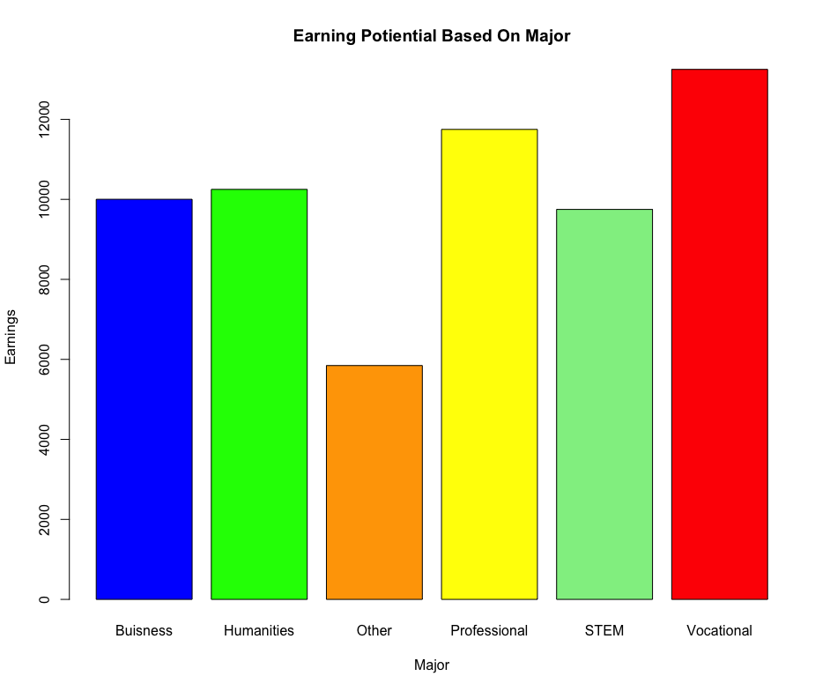
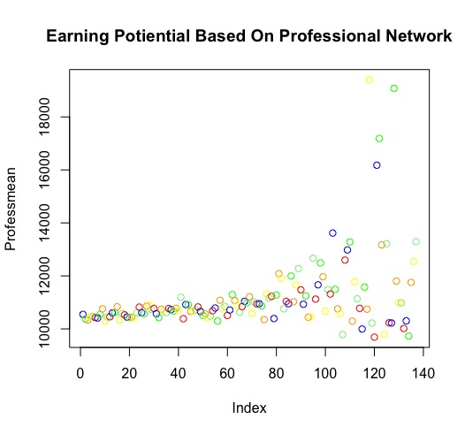
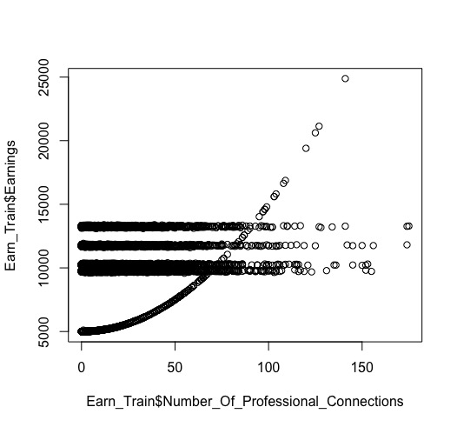
Plots
Below illustrates earning potential based on the majors
As we can see it appears vocational shows the highest earnings followed by professional, business and STEM being the highest. This tells us there is a greater level of significance in earnings compared to Humanities, and Other.
In addition professional connections also has an impact on overall earnings, thus making earnings based on major and professional have the highest levels of exponential growth.

Slide 4
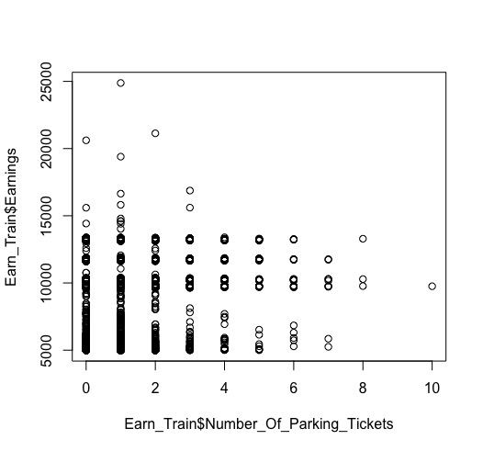
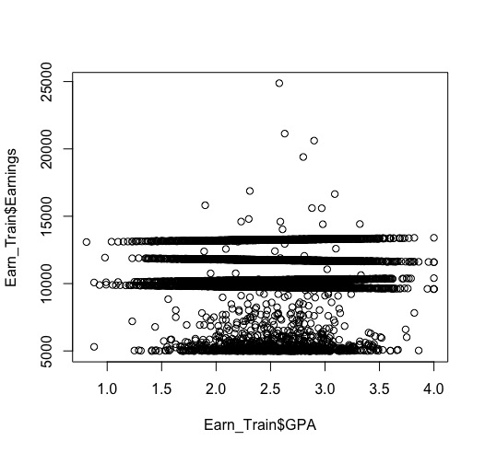
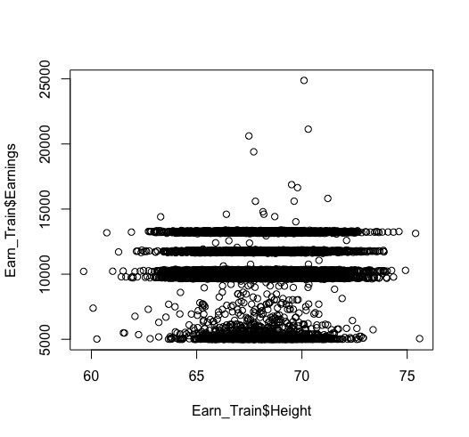
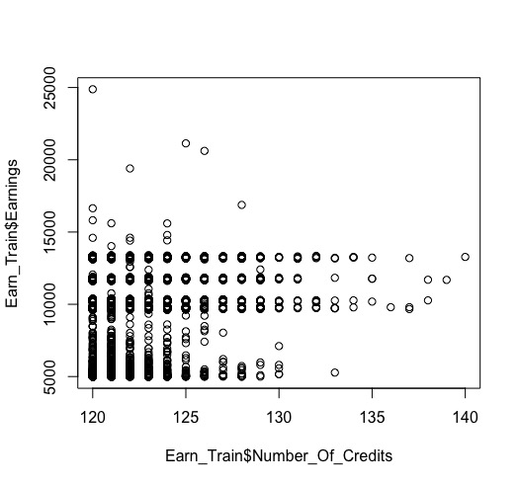
Additional Plots
These other plots were created to see how the other attributes affected the overall dataset.
Interestingly enough, by including attributes such as Parking tickets, GPA, Height, and number of credits the results appear stagnate. There is minimal amount of growth which tells us these parameters are insignificant to what is being predicted.

Slide 5
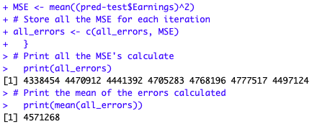
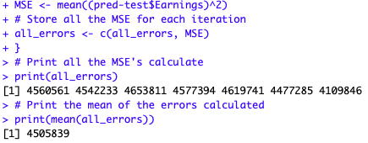
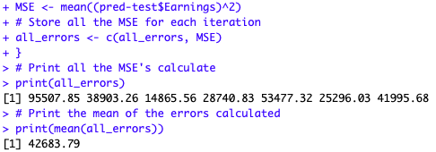
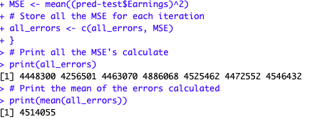
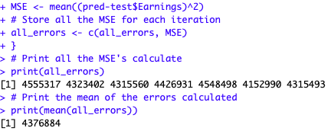
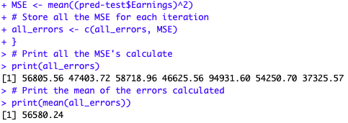
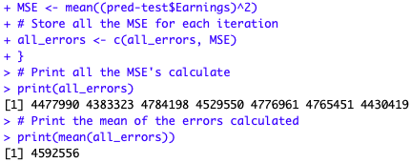
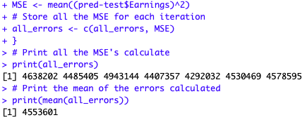

Cross Validation & Prediction
Cross validation function is used to analyze the dataset based on the predictions made. Here there are 10 prediction result

Slide 6
Conclusion
After analyzing all attributes through plotting containing the most significance appeared was professional connections with earnings and also earnings and major.
The other attributes such as GPA, Height, and Parking tickets showed a stagnate illustration which tells us there is no significance from these attributes.
It appears utilizing all attributes across all the trees increased the overall score to register 12665.580. This score result is interesting because it shows why alternating parameters can change the overall prediction rate.

